Slide 1





STUDIES ON REVERSIBLE LOGIC BASED GATES AND CIRCUITS FOR ARITHMETIC OPERATIONS
A.Kamaraj
[Reg. No. 1414489180]
Ph.D. Scholar (Part-time),
Anna University, Chennai.
SUPERVISOR
Dr.P.Marichamy,
Department of ECE,
P.S.R. Engineering College, Sivakasi

Slide 2


CONTENTS
Contents
Introduction
Literature Review – ALU, Division, Multiplier
Proposed Reversible KMD Gates
Design of Arithmetic Logic Unit (ALU)
Design of Floating Point Division
Design of Vedic Multiplier
Quantum Cellular Automata (QCA) Simulation
Performance Comparisons
Conclusion
Publications

Slide 3
Introduction
Reversible Logic
Properties of Reversible Gate

Slide 4
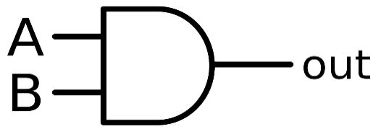
Introduction to Reversible Logic
INTRODUCTION
Need:
Low Power Dissipation is a major challenge in VLSI Circuits.
CMOS Logic Loses bit(s) during Computation => KTln2 (Landauer (1961) and Bennett (1973))
Solution:
One method is REVERSIBLE LOGIC.
REVERSIBLE LOGIC = ONE to ONE Mapping (No. of I/Ps = No. of O/Ps)
A
A
B
B
C=0
AB⊕C
Conventional Logic
Reversible Logic

Slide 5
Introduction to Reversible Logic
INTRODUCTION
Basic Reversible Gates – Feynman, Fredkin, Toffoli
Performance Metrics – Quantum Cost (QC), Garbage Outputs (GO), Constant Inputs (CI), Number of Gates (NoG)
Ex.: A, B – Inputs; C=0 (Constant Input); R=A.B (Output); P,Q=Garbage Output
TOFFOLI GATE
A
P=A
B
Q=B
C=0
R=AB⊕C

Slide 6
Properties of Reversible Gate
INTRODUCTION
Reversibility
- Unique Mapping
Universality
- Produce AND/NAND, OR/NOR, NOT
Parity Preservation
I₁⊕ I₂⊕ I₃⊕ ... ⊕ I_{i} = O₁⊕ O₂⊕ O₃⊕ …⊕ O_{i}

Slide 7

Objectives of the Research
OBJECTIVES
To analyze the reversible logic gates and circuits that are reported in the literature qualitatively and make a comparison among them.
To propose new reversible logic gates having more functionality with parity preservation capability.
To design the digital circuits for arithmetic operations with a variety of existing and proposed reversible logic gates and compare their performances for suitability.

Slide 8



Literature Review

Slide 9
Reversible Gates – A Comparison
LITERATURE REVIEW
S. No. | Author | Year | Name of the Gate | Size of the Gate | Quantum Cost | Application | Remark
1. | Prashanth, N.G et. al. | 2013 | MIG | 6×6 | 7 | Full Adder/ Subtractor | Higher Size
2. | Vasudevan DP et al. | 2006 | R gate | 3×3 | 6 | basic logical functions | R, U – Yes; PP – No
3. | Thapliyal H et. al. | 2009 | TR gate | 3×3 | 7 | Full Adder/ Subtractor | R, U – Yes; PP – No
4. | Mahammad S K N et. al. | 2010 | URG | 3×3 | 10 | Logical Functions & FFs | R, U – Yes; PP – No
5. | Roohi A et. al. | 2016 | PPRG | 3×3 | 19 | Full Adder | R, PP – Yes; U – No
6. | Thapliyal H et. al. | 2005 | TSG | 4×4 | 33 | Adder (BCD, CLA etc…) | R, U – Yes; PP – No
7. | Morrison et. al. | 2011 | MRG | 4×4 | 6 | ALU Design | 6 Operations only
8. | Neeraj Kumar et. al. | 2016 | UPPG | 4×4 | 10 | ALU Design | 14 Operations; R, U, PP - Yes
9. | Ali Newaz et. al. | 2015 | NFT | 4×4 | 9 | QCA Realization | Used Majority voter gates
R- Reversibility; U-Universality; PP-Parity Preservation
Inferences:
All Reversible Gates are having Reversibility
Most of them are having Universality
Rarely they have Parity Preservation
New reversible gates are introduced to improve functionality and performance

Slide 10
Types of Reversible Gates
LITERATURE REVIEW
3×3 Reversible Gates
4×4 Reversible Gates
Peres
R Gate
TR Gate
URG Gate
PPRG Gate
SAM Gate
RM Gate and
RUG Gate
TSG Gate
HNG Gate
MRG Gate
UPPG Gate
PAOG Gate
SMS Gate
OTG Gate

Slide 11
ALU – A Review
LITERATURE REVIEW
Author | Year | Type and No. of Functions | Basic Gate | Special Gate | Parity | QC | Remarks
Saligram R et. al. | 2013 | 8 (Arith.) + 4 (Logic) | F2G, Toffoli | IG, PPPG | Yes | 108 | Adder is included as separate unit
Kaur T et. al. | 2013 | 8 (Arith.)+ 7 (Logic) | Fredkin | FTRA | Yes | 41 | Cost is increased when FTRA is included
Mukhopadhyay M et. al. | 2013 | 4 (Arith.)+ 7 (Logic) | F2G, Peres, Toffoli | PPPG | Yes | 75 | Mux based Boolean function generator
Bibhash S et. al. | 2014 | 7 (Arith.) + 9 (Logic) | Feynman, Peres | RM | Yes | 320 | Mux is used for combining Logical and Arithmetic unit
Lenin G et. al. | 2014 | 7 (Arith.)+ 4 (Logic) | - | PFAG, HNG | No | 67 | Control Unit for ALU is introduced.
Chaves F et. al. | 2015 | 8 Logical | Feynman, Toffoli | - | No | - | No Arithmetic operations
Trailokya N et. al. | 2016 | 7 (Arith.) + 9 (Logic) | Toffoli | RUG | Yes | 197 | Mux is used for combining Logical and Arithmetic unit
Armin N et. al. | 2017 | 4 (Arith.) + 7 (Logic) | Feynman, Fredkin | NHG | Yes | 19 | Integrated ALU Structure
Vandana S et. al. | 2018 | 8 - Arith. | Feynmann | DKG | No | - | No logical operations
Abdul B et. al. | 2019 | 4 (Arith.)+ 6 (Logic) | Feynman, Fredkin | HNG, PAOG, MRG | No | - | No Novelty, Architecture is Same as Bibhash S et. al.
Inferences:
QC – Quantum Cost
The number of operations are 4 to 16
The number of operations increases the Quantum Cost
Separate modules for Arithmetic and Logic Unit (Multiplxer is used for combining them)

Slide 12
DIVISION – A Review
LITERATURE REVIEW
Author | Year | Major Contribution | Basic Gate | Special Gate | Parity | Remarks
Faraz D et. al. | 2011 | FP Division (PIPO reg.) | F2G, Fredkin | - | Yes | FP Mux, Adder, n-bit
Faraz D et. al. | 2012 | Signed Division | F2G, Fredkin | - | No | n-bit, OVF Detection
Jamal L et. al. | 2013 | FP Divider | Feynman | DPG | No | 16 bit division (Array)
Sayedsalehi S et. al. | 2015 | FP Adder, Multiplication, Division | Feynman, Fredkin | - | No | Only Architecture
Anantha Lakshmi AV et. al. | 2017 | FP Arithmetic | Feynman, Fredkin | TR | No | Add/sub, Multiplication, Division, Square root
NON-RESTORING DIVISION
AnanthaLakshmi AV et. al. | 2015 | Restoring and Non-Restoring Division | Majority Voter | - | No | Array, Fixed point
Hafiz M et. al. | 2016 | FP Division | F2G, Fredkin | RR | Yes | n-bit
Ali B et. al. | 2016 | Non-Restoring Division | F2G, Fredkin | BHA, BHB, BBHC, BHD | No | n-bit
Mohammad M et. al. | 2017 | CAS, Non-Restoring Division (6×6) | Majority Voter | - | No | Array, Fixed point
Inferences:
Non-restoring algorithm has minimum number of steps
New reversible gates are used for Division
Many do not have parity preservation

Slide 13
MULTIPLIER – A Review
LITERATURE REVIEW
Author | Year | Major Contribution | Basic Gate | Special Gate | PP | QCkt | Remarks
Poornima M et. al. | 2013 | 8×8 Vedic | - | - | - | - | Not Reversible
Siba Kumar P et. al. | 2015 | 8×8 Vedic | - | - | - | - | Not Reversible
Rakshith TR et. al. | 2013 | 4×4 Vedic | Peres, Feynman | HNG | No | No | First Reversible
Rakshith S et. al. | 2013 | 4×4 Vedic | Peres , Feynman | NFT, BVPPG | No | No | Cost reduction than Rakshith TR et. al.
Shifana AP et. al. | 2014 | Array Vs Vedic | Peres, Feynman | HNG | No | No | Vedic Performs Better
Srikanth G et. al. | 2014 | 32×32 Vedic, Array Vs Vedic | Peres, Feynman | HNG | No | No | Vedic Performs Better
Gowthami P et. al. | 2018 | 16×16 Vedic | Peres , Feynman | HNG, BME | No | No | -
Ashvin C et. al. | 2018 | N×N | Majority Voter | - | No | No | Better than High speed Multipliers
PP – Parity Preservation; QCkt – Quantum Circuit
Inferences:
Vedic Multipliers are better than array and high speed multipliers
No Vedic multipliers with Parity Preservation
Quantum circuit is not yet obtained

Slide 14

Research Carried Out
RESEARCH
Studies on Reversible Logic based Gates and Circuits for Arithmetic Operations
Proposed Gates
ALU
FP Division
Vedic Multiplier
Gates
KMD Gate1
KMD Gate2
KMD Gate3
KMD Gate4
Outcome
Average NoG 1.76, QC 18.23
5 Logical functions per Gate
Reduced Area
Modules
Logic gates (NOT, OR, AND, XOR)
Adder
Multiplexer
Outcome
10 Arithmetic, 8 Logical Operations
Integrated Architecture
Improved Performance
Modules
Multiplexer
Adder
Multi-functional Register
Control Unit
Outcome
Performance Metrics Linear with ‘n’
Higher Order Designs has Better Performance
Modules
AND Logic
Adders
Ripple Carry Adder
2×2 Multiplier
Outcome
Parity Preserving VM
Improved Performance
NoG – Number of Gates
VM – Vedic Multiplier
‘n’ – Number of Bits
Simulation
Quantum Cellular Automata
Quantum Circuit
Measures
Quantum Cost
Constant Inputs
Garbage Output
Logical Calculations

Slide 15
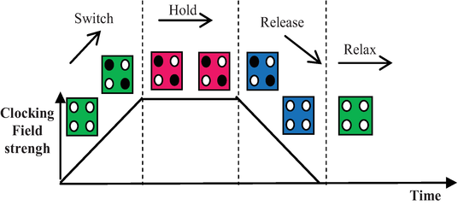
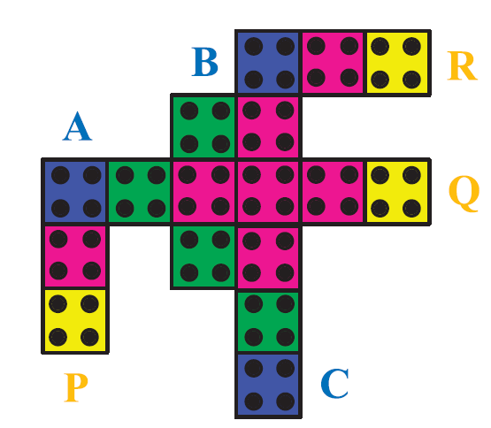
Proposed Reversible Logic Gates

Slide 16
Features
Properties of KMD Gates
Proposed Gates
Performance of KMD Gates
Quantum Circuit of KMD Gates
Derivatives of KMD Gates
Summary

Slide 17
PROPOSED GATES
Features of Proposed Reversible Gates
Maintain the uniformity of the design (designing the reversible circuits with the same type of gates).
Implement the reversible circuits with the new gates providing improved performance (with less cost in terms of Quantum Cost, Garbage Output and Logical Calculations).
New gates with more functionality and less area.

Slide 18
PROPOSED GATES
Proposed Reversible Gates
KMD Gate1
KMD Gate2
A
P=A
A
P=A
B
Q=A’C⊕AB’
B
Q=A’B’⊕AC
C
R=A’B⊕AC’
C
R=A’C’⊕AB
A
KMD Gate3
P=A⊕D
A
KMD Gate4
P=A
B
Q=B⊕C⊕D
B
Q=A’B⊕AC’
C
R=A⊕B⊕C
C
R=A’C⊕AB
D
S=A(B⊕ C)⊕BC⊕D
D
S=A’C⊕AB⊕D
E
T=BC’⊕E

Slide 19
PROPOSED GATES
Characteristics of KMD Gates
Reversibility
Universality
Parity Preservation

Slide 20
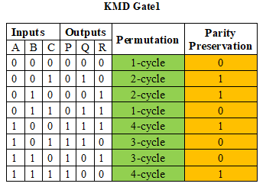
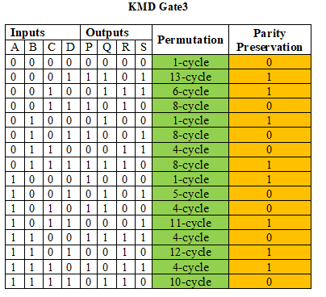
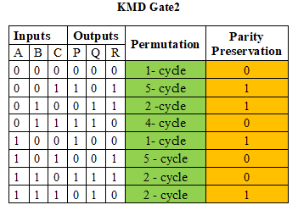
PROPOSED GATES
Reversibility and Parity Preservation of KMD Gates
KMD Gate1
A
KMD Gate3
P=A⊕D
A
P=A
B
Q=A’C⊕AB’
B
Q=B⊕C⊕D
C
R=A’C⊕AB
C
R=A’B⊕AC’
D
S=A’C⊕AB⊕D
KMD Gate2
A
P=A
B
Q=A’B’⊕AC
C
R=A’C’⊕AB

Slide 21
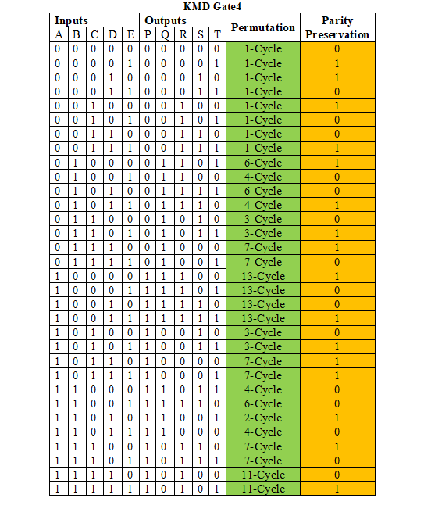
PROPOSED GATES
Reversibility and Parity Preservation of KMD Gates
A
KMD Gate4
P=A
B
Q=A’B⊕AC’
C
R=A⊕B⊕C
D
S=A(B⊕ C)⊕BC⊕D
E
T=BC’⊕E

Slide 22
PROPOSED GATES
Universality Property of KMD Gates
S. No. | Reversible Gate | Constant Input | Logic Function | Expression
1. | KMD Gate1 | A=1; C=0 / 1 | Q=NOT (B) | Q = R’
 |  | C=1 | Q = NAND (A,B) | Q = A’ + AB’
 |  | C=0 | R = OR (A, B) | Q = A + A’B
2. | KMD Gate2 | B=C=0 | R = NOT (A) | R = A’
 |  | C=0 | Q = NOR (A,B) | Q = A’B’ = (A+B)’
 |  | C=1 | R = AND (A,B) | R = AB
3. | KMD Gate3 | B=D=0; C=1 | S = NOT (A) | S = A’
 |  | B=1 | R = OR (A, C) | R = A + A’C
 |  | C=0 | R = AND (A, B) | R = AB
4. | KMD Gate4 | B=C=1;D=0 | Q = NOT(A) | Q = A’
 |  | B=1 | Q = NAND (A,C) | Q = A’ + AC’
 |  | B=1; D=0 C=0 | T = OR (A,C) Q = OR(A,C) | T = AC’ + C Q = AC’ + C

Slide 23
PROPOSED GATES
Characteristics and Performance of KMD Gates - Comparison
S. No. | Name of the Reversible Gate | Reversibility | Universality | Parity Preservation | Gate Count | Quantum Cost | Number of Functions (NoF) | Logical Calculations
1. | KMD Gate1 | Yes | Yes | Yes | 5 | 9 | 3 | 2α+4β+3γ
2. | KMD Gate2 | Yes | Yes | Yes | 6 | 10 | 4 | 2α+4β+3γ
3. | KMD Gate3 | Yes | Yes | Yes | 5 | 9 | 4 | 5α+3β+1γ
4. | KMD Gate4 | Yes | Yes | Yes | 8 | 12 | 5 | 6α+4β+2γ
Where, α – XOR; β – AND; γ – NOT gate functions

Slide 24
PROPOSED GATES
13 Standard Functions Realization – A Comparison
S. No | Standard Functions (Bibhash et al. 2014) | Toffoli |  | Peres |  | TR |  | Fredkin |  | RM |  | RUG |  | KMD
 |  | NoG | QC | NoG | QC | NoG | QC | NoG | QC | NoG | QC | NoG | QC | NoG | QC
1 | F=ABC | 2 | 10 | 2 | 8 | 2 | 12 | 4 | 20 | 2 | 70 | 2 | 62 | 2 | 18
2 | F=AB | 1 | 5 | 1 | 4 | 1 | 6 | 2 | 10 | 1 | 35 | 1 | 31 | 1 | 9
3 | F=ABC+AB’C’ | 3 | 15 | 3 | 12 | 2 | 12 | 3 | 15 | 2 | 70 | 2 | 62 | 4 | 36
4 | F=ABC+A’B’C’ | 10 | 50 | 10 | 40 | 9 | 54 | 4 | 20 | 3 | 105 | 3 | 93 | 3 | 27
5 | F=AB+BC | 5 | 25 | 4 | 16 | 4 | 24 | 2 | 10 | 2 | 70 | 2 | 62 | 2 | 18
6 | F=AB+A’B’C | 8 | 40 | 6 | 24 | 7 | 42 | 5 | 25 | 2 | 70 | 3 | 93 | 3 | 27
7 | F=ABC+A’BC’+AB’C’ | 8 | 40 | 7 | 28 | 8 | 48 | 6 | 30 | 3 | 105 | 3 | 93 | 5 | 45
8 | F=A | 1 | 5 | 1 | 4 | 1 | 6 | 1 | 5 | 1 | 35 | 1 | 31 | 1 | 9
9 | F=AB+BC+AC | 9 | 45 | 9 | 36 | 6 | 36 | 5 | 25 | 5 | 175 | 1 | 31 | 2 | 24
10 | F=AB+B’C | 6 | 30 | 6 | 24 | 5 | 30 | 1 | 5 | 1 | 35 | 1 | 31 | 1 | 9
11 | F=AB+BC+A’B’C’ | 4 | 20 | 4 | 16 | 3 | 18 | 6 | 30 | 2 | 70 | 2 | 62 | 2 | 18
12 | F=AB+A’B’ | 2 | 10 | 2 | 8 | 2 | 12 | 2 | 10 | 2 | 70 | 1 | 31 | 1 | 9
13 | F=ABC+A’B’C+AB’C’+A’BC’ | 2 | 10 | 2 | 8 | 2 | 12 | 3 | 15 | 2 | 70 | 2 | 62 | 2 | 24
 | AVERAGE | 4.69 | 23.4 | 4.38 | 17.5 | 4.23 | 24 | 3.15 | 16.9 | 2.15 | 75.3 | 1.84 | 57.2 | 1.76 | 18.23
Observations:
Average Number of Gates for realizing the Standard functions 1.76

Slide 25
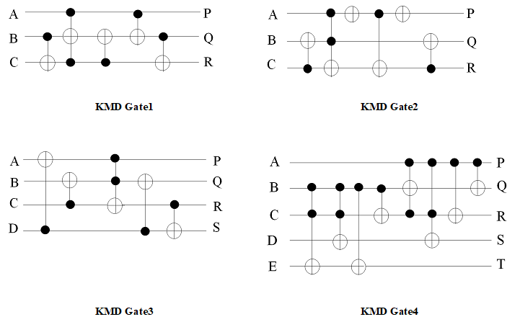
PROPOSED GATES
Quantum Circuit of KMD Gates

Slide 26
PROPOSED GATES
Derivative Functions from KMD Gates
Inverter function obtained from KMD Gate1
2×1 multiplexer & XOR gate is derived from KMD Gate3
AND logic is derived using KMD Gate2
OR logic is derived from KMD Gate1
Adder function from KMD Gate4
D latch function from KMD Gate3
Multi-functional register is derived from D-latch

Slide 27
PROPOSED GATES
Derivative Functions from KMD Gates
KMD Gate1 (Inverter)
A
P=G
1
Q=A’
A
KMD Gate3 (XOR)
P=A⊕B
0
Q=G
1
R=A’
0
R=G
B
S=G
KMD Gate1 (OR)
A
P=G
B
Q=G
Sel
KMD Gate3 (Mux)
P=G
0
R=A’B⊕A
A
Q=G
B
R=Sel’B⊕SelA
KMD Gate2 (AND)
A
P=G
0
S=G
B
Q=G
1
R=AB

Slide 28
PROPOSED GATES
Derivative Functions from KMD Gates
A
KMD Gate3 (Half Adder)
A⊕B
A
KMD Gate4 (Full Adder)
G
B
G
B
G
C
A⊕B⊕C
0
AB
0
A(B⊕ C)⊕BC
B
G
0
G
CLK
KMD Gate3
(D LATCH)
P=CLK
D
Q=G
R=CLK’.Q⊕CLK.D
0
S=Q

Slide 29
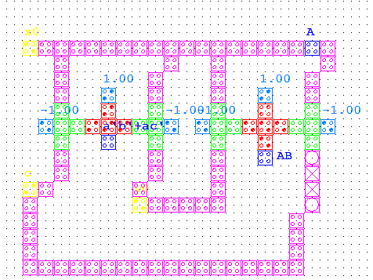
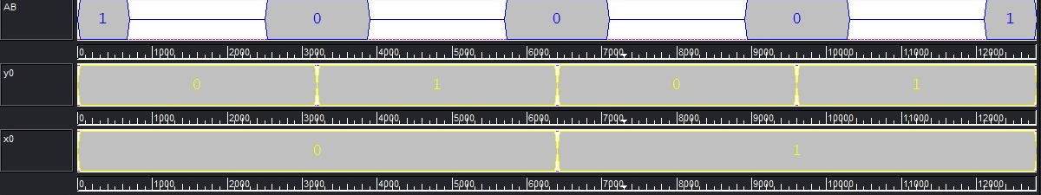
PROPOSED GATES
QCA Realization of KMD Gates
Inverter
KMD Gate1 (Inverter)
A
P=G
1
Q=A’
1
R=A’
AND Logic
KMD Gate2 (AND)
A
P=G
B
Q=G
1
R=AB

Slide 30
PROPOSED GATES
QCA Realization of KMD Gates Contd...
OR Logic
KMD Gate1 (OR)
A
P=G
B
Q=G
0
R=A’B⊕A
XOR Logic
A
KMD Gate3 (XOR)
P=A⊕B
0
Q=G
0
R=G
B
S=G

Slide 31
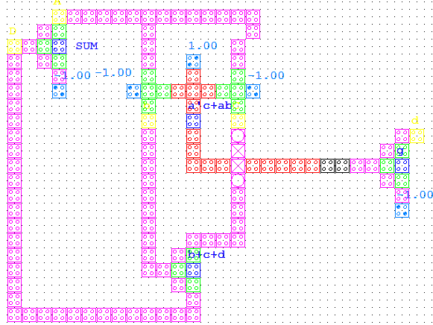
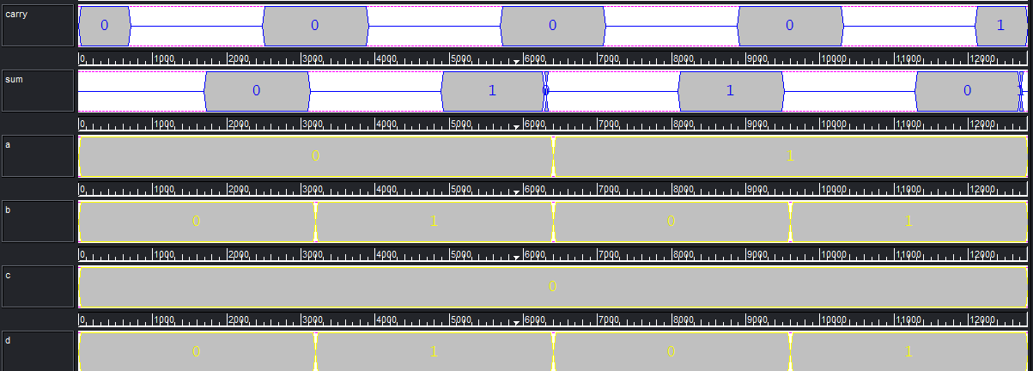
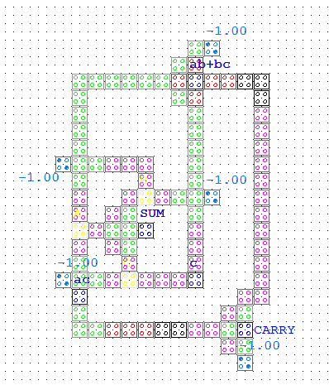
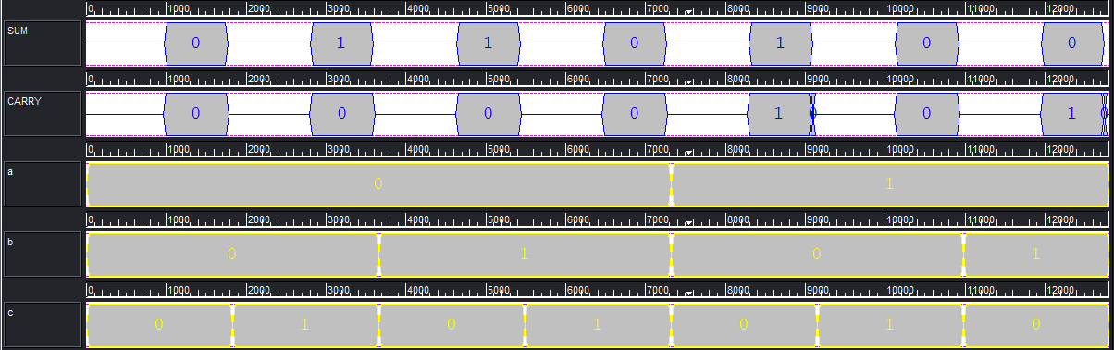
PROPOSED GATES
QCA Realization of KMD Gates Contd...
Half Adder
A
KMD Gate3 (Half Adder)
A⊕B
B
G
0
AB
B
G
Full Adder
A
KMD Gate4 (Full Adder)
G
B
G
C
A⊕B⊕C
0
A(B⊕ C)⊕BC
0
G

Slide 32
PROPOSED GATES
QCA Realization of KMD Gates Contd...
Multiplexer
Sel
KMD Gate3 (Mux)
P=G
A
Q=G
B
R=Sel’B⊕SelA
0
S=G

Slide 33
PROPOSED GATES
Summary
The proposed reversible KMD Gates satisfies the necessary properties of reversible logic.
They are capable of producing logical functions (Inverter, AND, OR and XOR), addition, multiplexer and D-Latch
The average number of gates required for realizing 13 Standard functions for KMD Gates is 1.76.
QCA Simulation for KMD Gates and its derivative functions are carried out.
Quantum circuit for the KMD Gates are obtained.

Slide 34
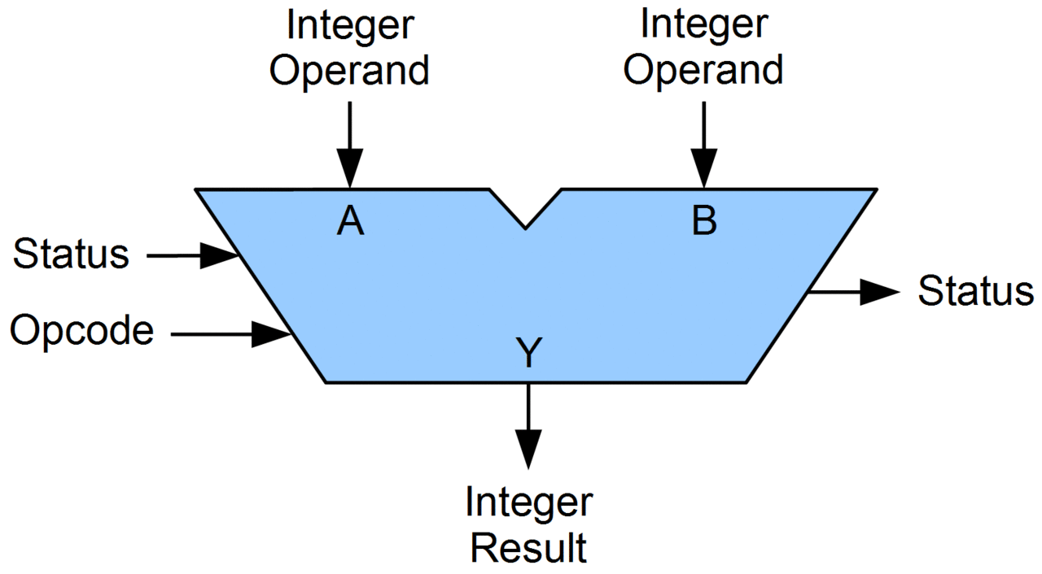
Arithmetic Logic Unit

Slide 35
Proposed ALU Architecture
Design Approaches
Proposed ALU
ALU Operations
QCA Realization and Quantum Circuit of ALU
Performance Evaluation
Summary

Slide 36
INTEGRATED ALU
Gaps identified in Existing ALU
The number of operations are 4 to 16
The number of operations increases the Quantum Cost
Separate modules for Arithmetic and Logic Unit
(Multiplxer is used for combining them)

Slide 37
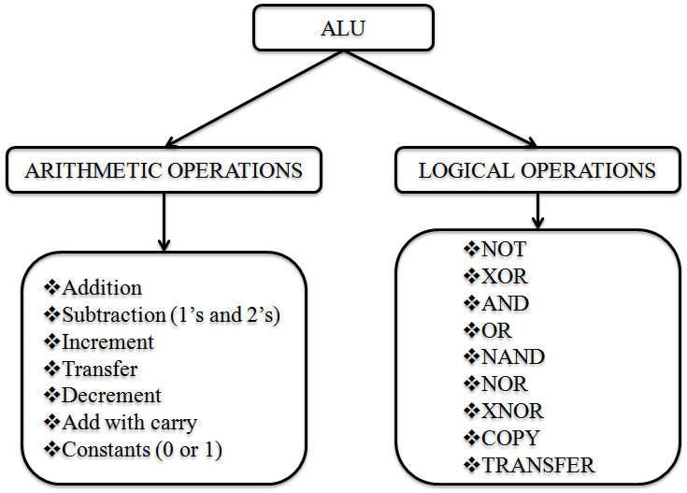
INTEGRATED ALU
Objective of Proposed ALU
An ALU is designed with an integrated functional module for performing both Arithmetic and Logical operations.

Slide 38
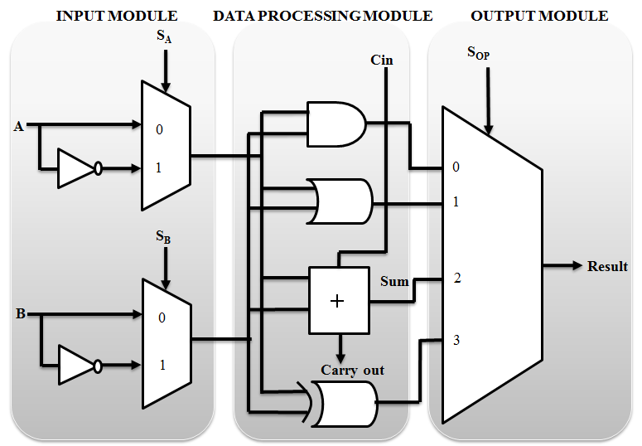
INTEGRATED ALU
Proposed ALU Architecture
S_{A} – Select Signal to forward A or ~A
S_{B} – Select Signal to forward B or ~B
S_{OP} – Select Signal to choose the
Operation

Slide 39
INTEGRATED ALU
Design Approaches of ALU
Approach 1:
All the functional modules (Input, Data processing & Output) are constructed only with KMD Gates.
Approach 2:
The functional modules are constructed using the combination of KMD Gates, Fredkin and Toffoli gates.

Slide 40
INTEGRATED ALU
Arithmetic Operations of Proposed ALU
Inputs | Constant Inputs | S_{A} | S_{B} | S_{OP} |  | Result | Type of Operation
A=A | B=1 | 0 | 0 | 0 | 0 | A | TRANSFER A
B=B | A=1 | 0 | 0 | 0 | 1 | B | TRANSFER B
A=A; B=B; Cin=Cin | - | 0 | 0 | 1 | 0 | Sum = A⊕B⊕Cin Carry out = AB + BCin + ACin | FULL ADDER
A=A; B=B; Cin=Cin | Cin = 1 |  |  |  |  | Sum = A⊕B⊕1 | ADD WITH CONSTANT CARRY
B=B | A=0 | 0 | 1 | 0 | 1 | B+1 | INCREMENT B
A=A; Cin=B | B=B | 0 | 1 | 1 | 0 | A+B | Add
A=A; B=B | - | 0 | 1 | 1 | 1 | A⊕B’ | 1’s Complement Addition
A=A | B=0 | 1 | 0 | 0 | 1 | A’ | INCREMENT A
A=A; B=B | Cin = 0 | 1 | 0 | 1 | 0 | Sum = A⊕B Carry out = AB | HALF ADDER
B=B | A=1 | 1 | 1 | 0 | 1 | B’ | DECREMENT B
B=B; Cin=Cin | A=0 | 1 | 1 | 1 | 0 | B’⊕Cin | 2’s Complement Addition
A=A | B=1 | 1 | 1 | 1 | 1 | A’ | DECREMENT A
Additional Functions:
Full Adder (Sum and Carry)
Decrement, Increment and Transfer for all Inputs

Slide 41
INTEGRATED ALU
Logical Operations of Proposed ALU
Inputs | Constant Inputs | S_{A} | S_{B} | S_{OP} |  | Result | Type of Operation
A=A; B=B | Cin=0 | 0 | 0 | 0 | 0 | AB | AND
 |  | 0 | 0 | 0 | 1 | A | B | OR
A=0; B=0; | Cin=0 | 0 | 0 | 1 | 0 | 1 | CONSTANT 1
A=A; B=B | - | 0 | 0 | 1 | 1 | A⊕B | XOR
A=A; B=B | - | 0 | 1 | 1 | 1 | (A⊕B)’ | XNOR
B=B | A=1 | 1 | 0 | 0 | 0 | 0 | CONSTANT 0
B=B | A=1 | 1 | 0 | 1 | 1 | B | COPY B
A=A; B=B | Cin=0 | 1 | 1 | 0 | 0 | A’B’= (A|B)’ | NOR
A=A; B=B | Cin=0 | 1 | 1 | 0 | 1 | A’|B’ = (AB)’ | NAND
A=A | B=0 | 1 | 1 | 1 | 1 | A | COPY A
Observations:
AND/NAND, OR/NOR, XOR, XNOR, COPY and CONSTANT

Slide 42
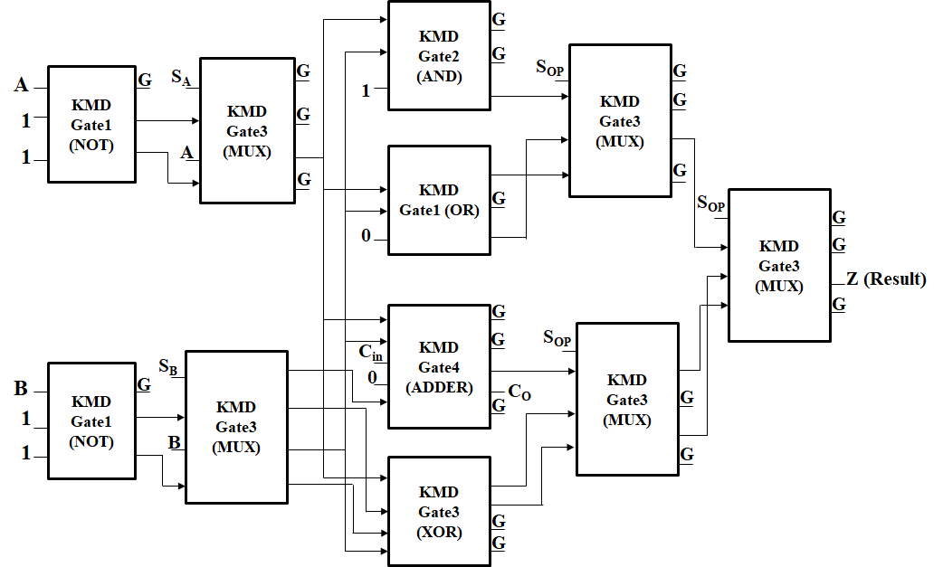
INTEGRATED ALU
Design Approach 1 (using KMD Gates)

Slide 43
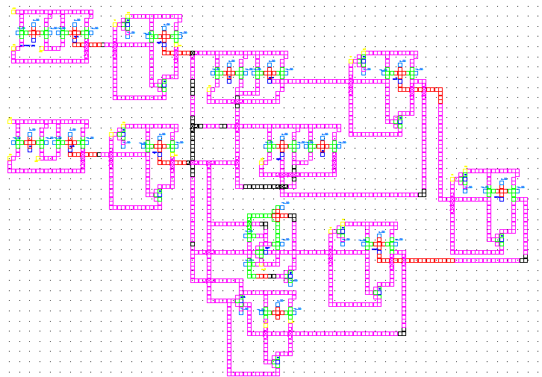
INTEGRATED ALU
QCA Realization of ALU (Approach 1)

Slide 44
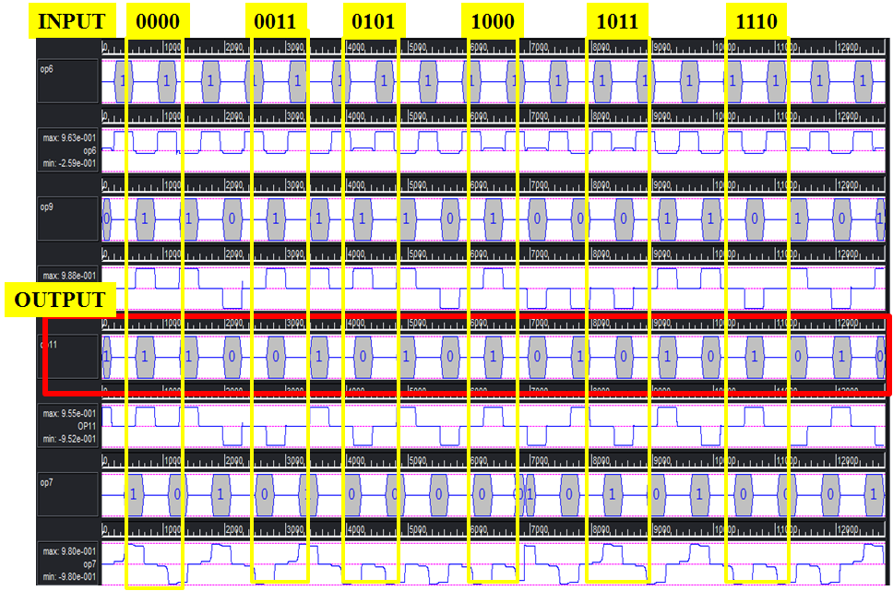
INTEGRATED ALU
QCA Simulation of ALU (Approach 1)

Slide 45
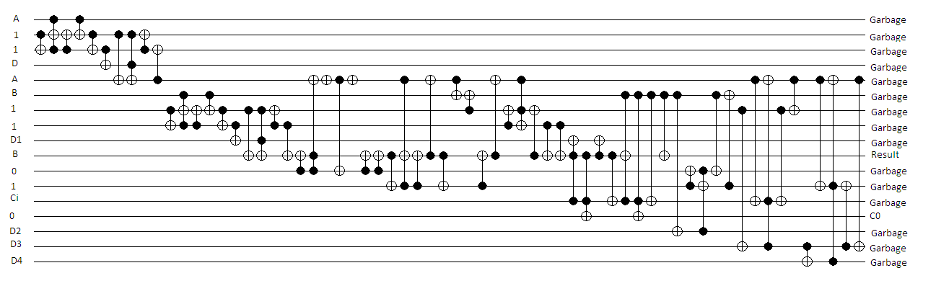
INTEGRATED ALU
Quantum Circuit of ALU (Approach 1)

Slide 46
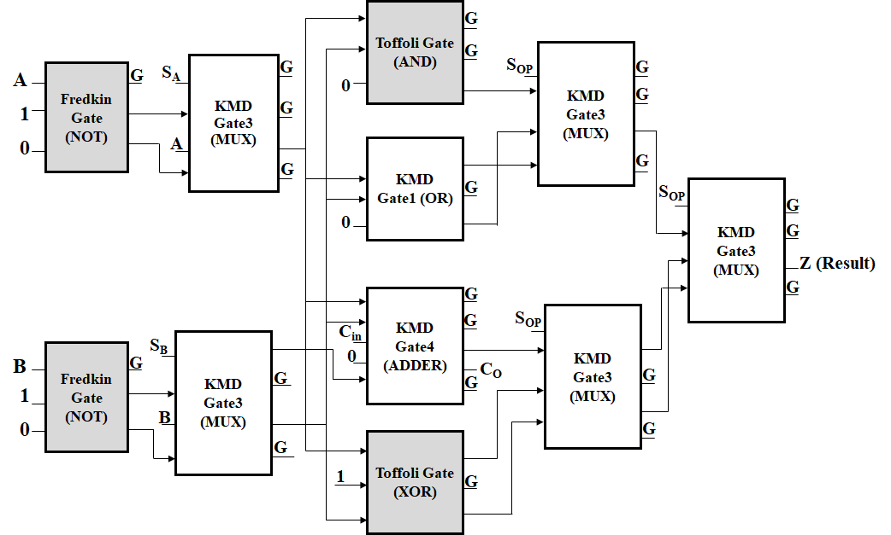
INTEGRATED ALU
Design Approach 2 (using Fredkin, Toffoli and KMD Gates)

Slide 47
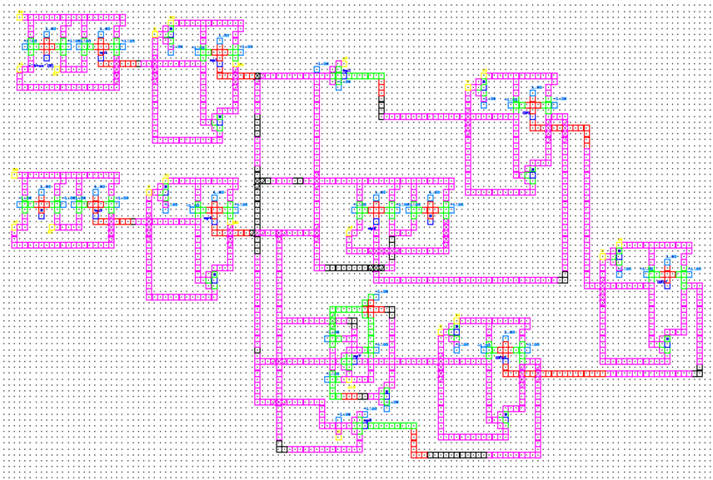
INTEGRATED ALU
QCA Realization of ALU (Approach 2)

Slide 48
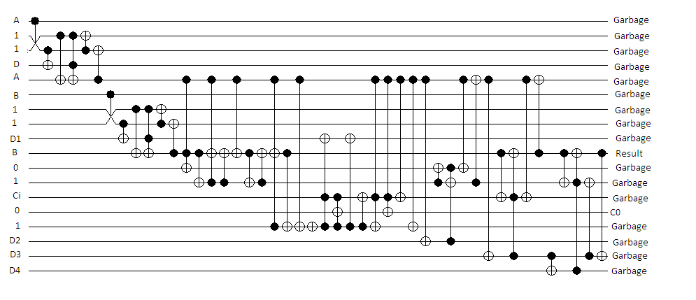
INTEGRATED ALU
Quantum Circuit of ALU (Approach 2)

Slide 49
INTEGRATED ALU
Number of Operations of ALU – A Comparison
Type of Operation | Number of Operations of ALU constructed using the Gates of
 | FTRA (Taranjot & Nirmal 2013) | PPPG (Rakshith et al. 2013) | NHG (Armin & Monireh 2017) | UPPG (Neeraj et al. 2016) | RM (Bibhash et al. 2014) | RUG (Trailokya et al. 2016) | KMD Gates Only (Approach-1) | Combination of KMD, Fredkin & Toffoli (Approach-2)
Arithmetic Operation | 8 | 4 | 4 | 8 | 7 | 7 | 10 | 10
Logical Operation | 7 | 7 | 7 | 8 | 9 | 9 | 8 | 8
Total | 15 | 11 | 11 | 16 | 16 | 16 | 18 | 18
% of improvement | - | - | - | - | - | - | 20% to 12.5% | 20% to 12.5%
Observations:
18 Logical and Arithmetic Functions

Slide 50
INTEGRATED ALU
Performance of ALU – A Comparison
Performance Metrics | ALU using |  |  |  |  |  | Proposed ALU Architecture
 | RM Gate (Bibhash et al. 2014) |  |  | RUG Gate (Trailokya et al. 2016) |  |  | Approach-1 (KMD Gates) | Approach-2 (KMD, Fredkin & Toffoli Gates)
 | Arithmetic Unit | Logical Unit | Total | Arithmetic Unit | Logical Unit | Total
Quantum Cost | 140 | 140 | 320 | 67 | 94 | 197 | 118 | 99
Constant Inputs | 2 | 2 | 10 | 0 | 1 | 6 | 7 | 8
Garbage Outputs | 6 | 7 | 15 | 3 | 6 | 11 | 21 | 22
No. of Gates Used | 4 | 4 | 14 | 3 | 4 | 14 | 11 | 11
Total Cost | 152 | 153 | 359 | 73 | 105 | 228 | 157 | 140
Logical Calculations | 2α+8β+3γ | α+9β+4γ | 8α+20β+9γ | 3α+β | α+6β+6γ | 9α+12β+11γ | 12α+14β+6γ | 12α+14β+6γ
Parameter | Improvement w.r.t. RM Gate (Bibhash et al. 2014) |  | Improvement w.r.t. RUG Gate (Trailokya et al. 2016)
 | Approach-1 | Approach-2 | Approach-1 | Approach-2
Quantum Cost | 63% | 69% | 40% | 49%
Constant Inputs | 30% | 20% | No | No
No. of gates used | 21% | 21% | 21% | 21%
Total Cost | 56.26% | 61% | 31.14% | 38.59%
Observations:
Quantum Cost, Constant Inputs and Number of Gates are reduced.

Slide 51
INTEGRATED ALU
Summary of Proposed ALU
Integrated ALU Architecture.
10 arithmetic and 8 Logical Operations; total of 18 operations.
Quantum cost is reduced by 69%, Constant input is reduced by 30% and Number of Gates is 21% reduced. Total cost reduction 61%.
QCA Realization and Simulations are performed; Quantum Circuit is obtained.

Slide 52

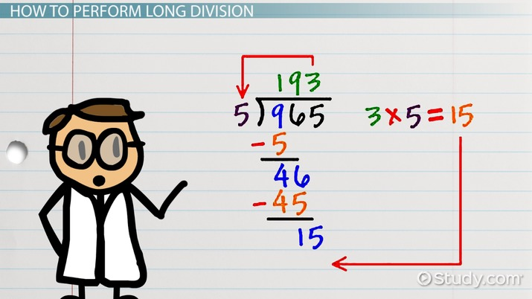

Floating Point Division

Slide 53
Non-Restoring Algorithm
Flow Diagram and Architecture
Proposed Division
Key Elements of Division
QCA Realization and Quantum Circuit
Performance Evaluation
Summary

Slide 54
INTEGRATED ALU
Gaps identified in Existing FP Division
Performance cost (QC, CI, NoG) increasing quadratically with ‘n’

Slide 55
DIVISION
Difference between Restoring & Non-Restoring Division
If the result is negative,
Restoring method:
Add the divisor back, and put ‘0’ as next quotient digit
Non-Restoring method:
Keep negative remainder, and basically correct things by a supplementary addition afterwards.
Non-Restoring is faster (max. n+1 steps for n digits)
Restoring method needs up to 2n-1 steps

Slide 56
DIVISION
Non-Restoring Division Algorithm
Inputs: Dividend (D); Divisor (V) and Select (Sel) = 0.
Outputs: Remainder (R) and Quotient (Q)
Steps:
Set Initially: Clk = High; SP = 0; Sel = 0;
Initialize the Registers: Count = 0; D = 0; V = 0
If (Clk = 1)
If (SP = = 0)
n-bit inputs are loaded in parallel in to operand registers (D & V).
Else if (SP = =1 & Hold = = 0 & Count < n)
The operands are forwarded to n-bit parallel adder (as per non-restoring algorithm 2’s complement addition).
The output of the previous step is loaded into D register and serial left shift one position in PIPO shift register.
If the partial result is positive (i.e. MSB = 0), set Q₀ = 1; otherwise set Q₀ = 0;
Count = Count + 1;
If (Count >= n)
If the result is negative; restore D and do rounding and normalization.
Dividend register MSB = Remainder; LSB = Quotient.
End.
Initialization
Load Inputs
Repeated Subtraction
for n times
Final Result

Slide 57
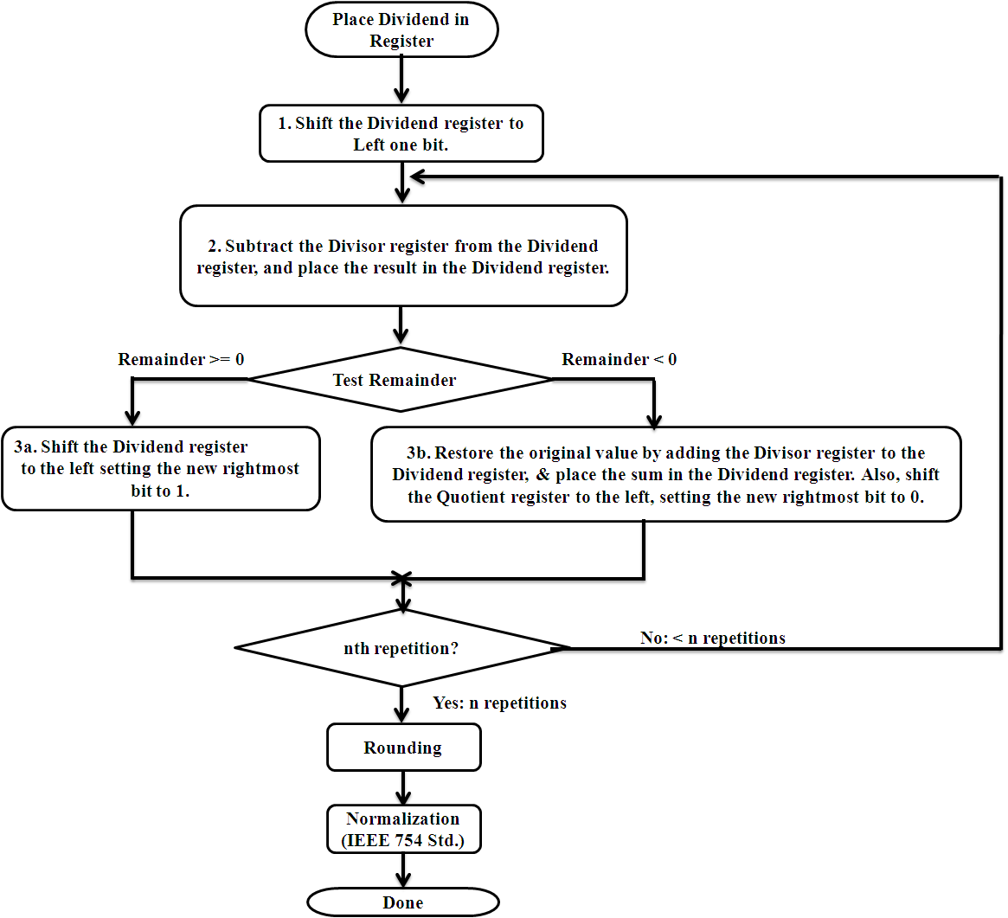
DIVISION
Flow Diagram of FP Division Algorithm

Slide 58
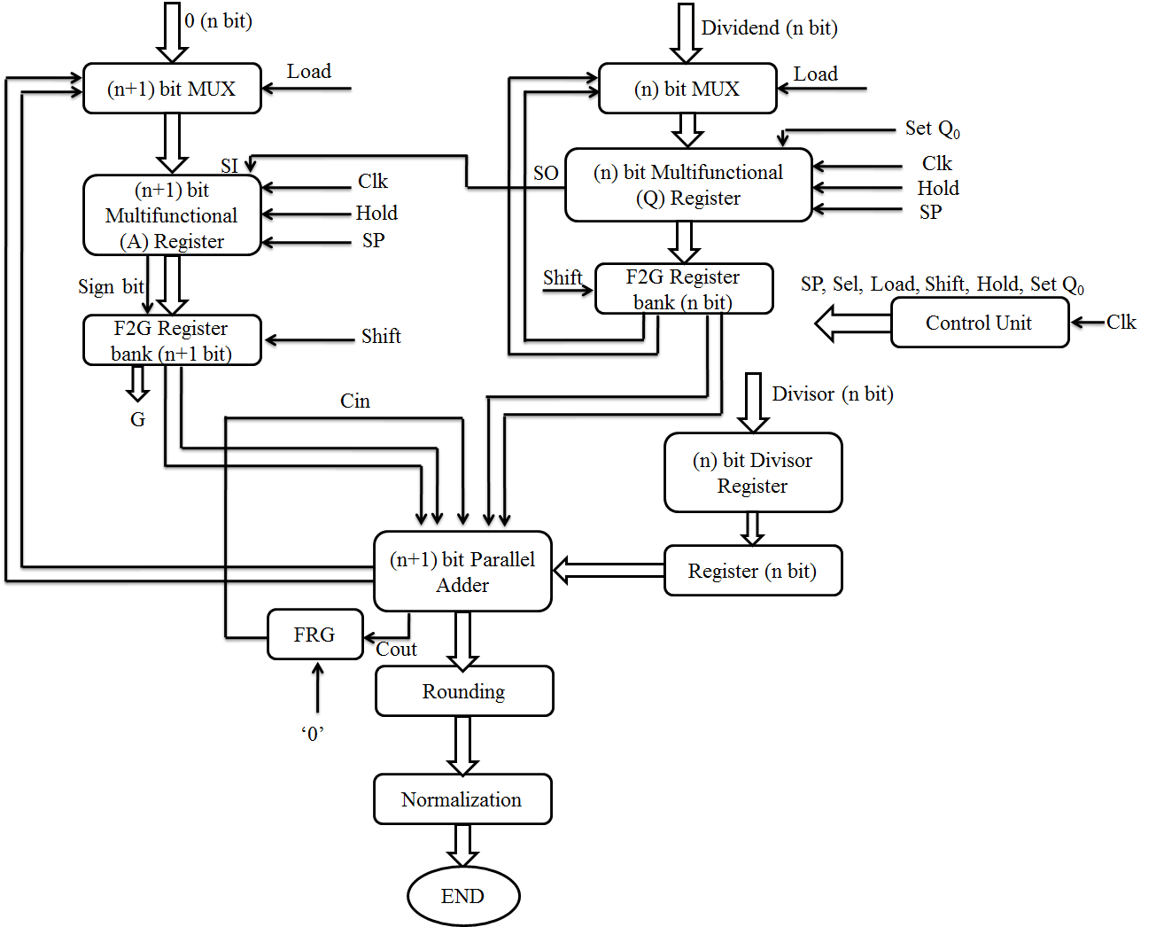
DIVISION
FP Division Architecture

Slide 59
DIVISION
Key Elements of Division Unit
Multiplexer
Parallel In Parallel Out Register
Multi-functional Register
Parallel Adder

Slide 60
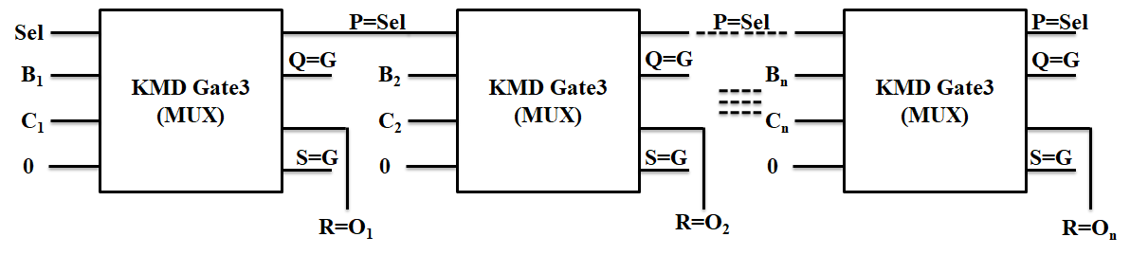
DIVISION
Key Elements of Division Unit
Multiplexer
Input | Outputs
Select Line (A = Sel) | P = Sel ⊕ D | R = Sel’ C ⊕ Sel B
0 | Sel | C
1 | Sel | B

Slide 61
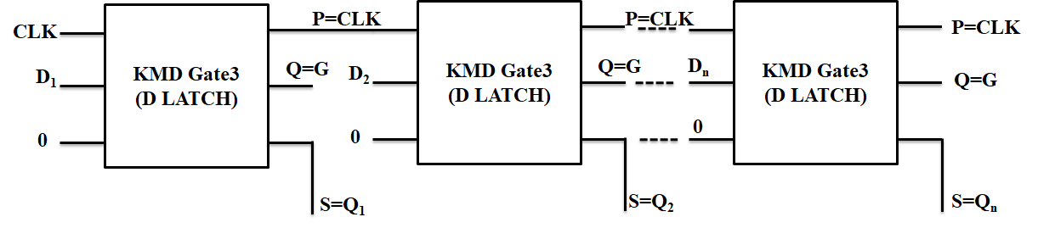
DIVISION
Key Elements of Division Unit
Parallel In Parallel Out

Slide 62
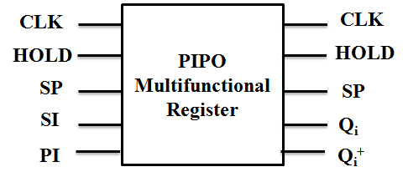
DIVISION
Key Elements of Division Unit
Multifunctional Register
Hold | SP | Q_{i}⁺ (Next Output) | Operation
0 | 0 | Ii | Input Loaded to Register in Parallel
0 | 1 | Q_{i-1} | Left Shift & LSB receiving input from Serial Input
1 | X | Q_{i} | Maintaining Previous Value
Q_{i}⁺ = Hold’ SP’ I_{i} + Hold’ SP Q_{i-1} + Hold Q_{i}
SP – Serial / Parallel Control Signal
SI – Serial Input
PI – Parallel Input

Slide 63
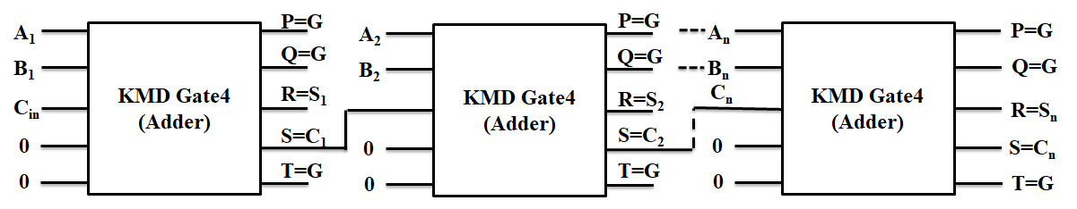
DIVISION
Key Elements of Division Unit
Parallel Adder

Slide 64
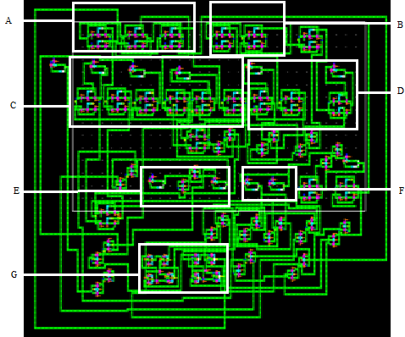
DIVISION
QCA Realization of Division Unit
A) 3-bit Multiplexer
B) 2-bit Multiplexer
C) 3-bit Shift Register
D) 2-bit Shift Register
E) Rounding Register
F) Normalization Register
G) Parallel Adder

Slide 65
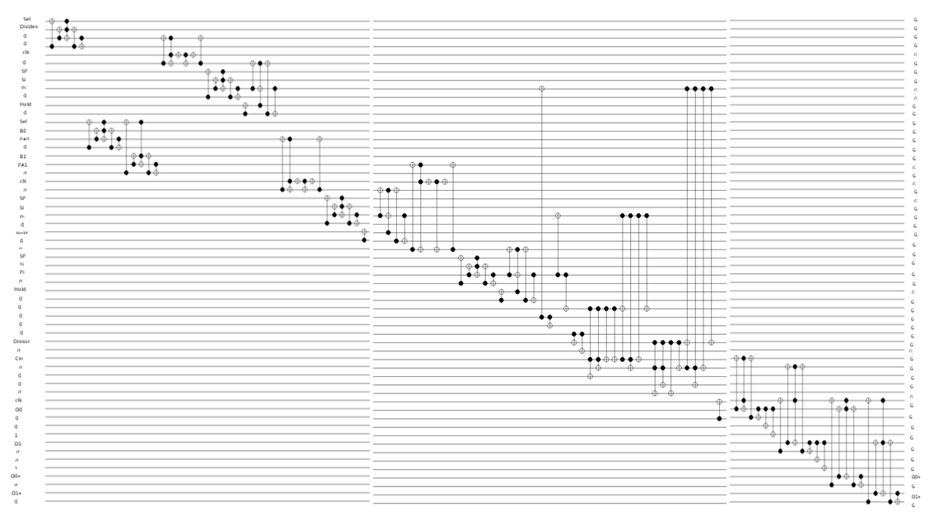
DIVISION
Quantum Circuit of Division Unit

Slide 66
DIVISION
Performance of Division Unit
S. No. | Functional Module | Number of Bits | Gates Used | Number of Gates | Quantum Cost | Garbage Output | Constant Input
1. | Multiplexer | n | KMD Gate3 | n | 6n | 2n | n
 |  | n+1 |  | n+1 | 6n + 6 | 2n+2 | n+1
2. | Multifunctional Register | n |  | 2n | 18n | 5n | 3n
 |  | n+1 |  | 2n+1 | 18n+18 | 5n+5 | 3n+3
3. | Divisor Register | n | F2G | n | 2n | 2n | n
4. | Parallel Adder | n+1 | KMD Gate4 | n+1 | 12n+12 | 3n+3 | 2n
5. | Register | n | F2G | n | 3n | - | n
 |  | n+1 |  | n+1 | 3n+3 | n+1 | n+1
6. | Other Gates | 1 | Fredkin | 1 | 5 | 2 | 1
 | Total Cost (of Division Unit) |  |  | 12n+4 | 68n+44 | 20n+13 | 13n+6
Observations:
Number of Gates 12n+4; Quantum Cost 68n+44; Garbage Output 20n+13; Constant Inputs 13n+6

Slide 67
DIVISION
Performance Comparison
Parameters | Existing (Faraz & Majid 2011) |  | Existing (Jamal & Hasan 2013) |  | Proposed
 | Restoring | Non-Restoring | Conventional Division Array | High Speed Division Array
No. of Gates | 18n+23 | 18n+21 | (3(n+2)²+2n)/4 | (n+2)(3n+11)/2 | 12n+4
Garbage outputs | 12n+18 | 12n+16 | (n+2)²/2 | (n+2)(3n+22)/4 | 20n+13
Quantum Cost | 75n+60 | 75n+53 | (4(n+2)²+n)/2 | (n+2)(7n+27)/2 | 68n+44
Constant Input | 11n+14 | 11n+12 | ((n+1)²+1)/2 | (n+2)(3n+14)/4 | 13n+6
Total Cost (QC + GO + CI + NoG) | 116n+115 | 116n+102 | - | - | 113n+67
Observations:
Proposed method is having linear relationship with ‘n’ (number of bits)

Slide 68
DIVISION
Performance Comparison – Quantum Cost
Number of Bits | Existing (Faraz & Majid 2011) |  | Existing (Jamal & Hasan 2013) |  | Proposed | Percentage (%) of improvement w.r.t.
 | Res. | Non-R. | Conv. | HS Div. |  | (Faraz & Majid 2011) | (Jamal & Hasan 2013)
2 | 210 | 203 | 33 | 82 | 180 | 11.33 - 14.29 | No
4 | 360 | 353 | 74 | 165 | 316 | 10.48 - 12.22 | No
8 | 660 | 653 | 204 | 415 | 588 | 9.95 - 10.91 | No
16 | 1260 | 1253 | 656 | 1251 | 1132 | 9.66 - 10.16 | 9.51
32 | 2460 | 2453 | 2328 | 4267 | 2220 | 9.5 - 9.76 | 4.64 - 47.94
64 | 4860 | 4853 | 8744 | 15675 | 4396 | 9.42 - 9.55 | 49.73 - 71.96
128 | 9660 | 9653 | 33864 | 59995 | 8748 | 9.38 - 9.44 | 74.17 - 85.42
256 | 19360 | 19253 | 133256 | 234651 | 17452 | 9.35 - 9.86 | 86.9 - 92.56
Observations:
Quantum cost is 9% reduced w.r.t. Faraz (2011)

Slide 69
DIVISION
Performance Comparison – Number of Gates
Number Of Bits | Existing (Faraz & Majid 2011) |  | Existing (Jamal & Hasan 2013) |  | Existing (Hafiz & Solaiman 2016) | Proposed | Percentage (%) of improvement w.r.t.
 | Res. | Non-R. | Conv. | HS Div. |  |  | (Faraz & Majid 2011) | (Jamal & Hasan 2013) | (Hafiz & Solaiman 2016)
2 | 59 | 57 | 13 | 34 | 44 | 28 | 50.8 -52.5 | 17.65 | 36.36
4 | 95 | 93 | 33 | 69 | 70 | 52 | 44.1 -45.26 | 24.64 | 25.71
8 | 167 | 165 | 79 | 175 | 122 | 100 | 39.4 -40.12 | 42.86 | 18.03
16 | 311 | 309 | 251 | 531 | 226 | 196 | 36.5 -36.9 | 21.9 - 63 | 13.27
32 | 599 | 597 | 883 | 1819 | 434 | 388 | 35 -35.23 | 56 - 78.6 | 10.6
64 | 1172 | 1173 | 3299 | 6699 | 850 | 772 | 34.2 | 76.6 -88.4 | 9.18
128 | 2327 | 2325 | 12739 | 25675 | 1682 | 1540 | 33.8 | 87.9 - 94 | 8.44
256 | 4631 | 4629 | 50051 | 100491 | 3346 | 3076 | 33.5 | 93.8 -96.9 | 8.07
Observations:
NoG Linear with ‘n’ in proposed method; it is quadratic in Jamal (2013)

Slide 70
DIVISION
Performance Comparison – Constant Input
Number of Bits | Existing (Faraz & Majid 2011) |  | Existing (Jamal & Hasan 2013) |  | Proposed | Percentage (%) of improvement w.r.t.
 | Res. | Non-R. | Conv. | HS Div. |  | (Faraz & Majid 2011) | (Jamal & Hasan 2013)
2 | 36 | 34 | 5 | 20 | 32 | 5.8 - 11.11 | No
4 | 58 | 56 | 13 | 39 | 58 | No | No
8 | 102 | 100 | 41 | 95 | 110 | No | No
16 | 190 | 188 | 145 | 279 | 214 | No | 23.3
32 | 366 | 364 | 545 | 935 | 422 | No | 22.5 - 54.8
64 | 718 | 716 | 2113 | 3399 | 838 | No | 60.3 - 75.3
128 | 1408 | 1406 | 8321 | 12935 | 1670 | No | 79.9 - 87.1
256 | 2830 | 2828 | 33025 | 50439 | 3334 | No | 89.9 - 93.4
Observations:
Constant Input is reduced w.r.t. Jamal (2013) for higher values of ‘n’.

Slide 71
DIVISION
Summary
Non-restoring algorithm is followed for Floating point division
Key elements are multiplexer, adder / subtractor and registers
The quantum cost (68n+44), number of gates (12n+4), garbage output (20n+13), constant input (13n+6) and total cost (113n+67) of the proposed ‘n’ bit division unit have been estimated.
The proposed method shows better performance for higher order bits (n)
QCA realization and Quantum circuit is completed.

Slide 72
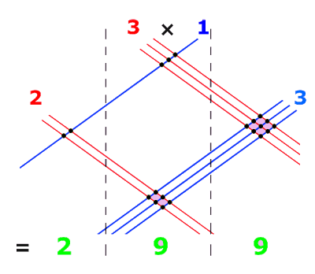

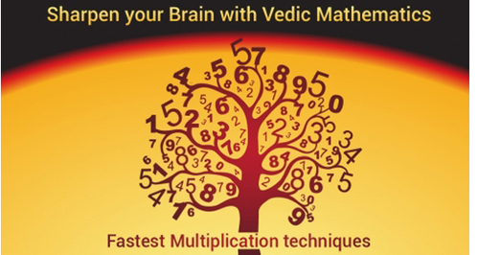
Vedic Multiplier

Slide 73
2×2 Vedic Multiplication (VM)
Design Approaches
Proposed Multiplier
2×2 Vedic Multiplication
QCA Realization and Quantum Circuit
Performance Evaluation
Summary

Slide 74
INTEGRATED ALU
Gaps identified in Existing Vedic Multipliers
No Vedic multipliers with Parity Preservation
Quantum circuit is not yet obtained

Slide 75
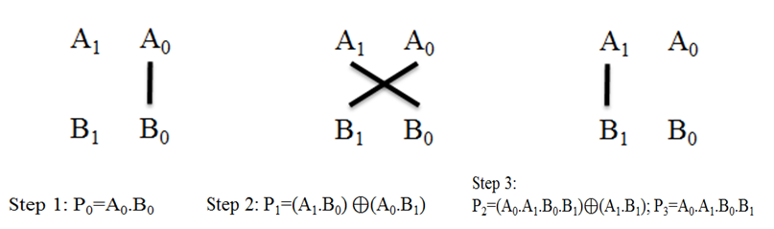
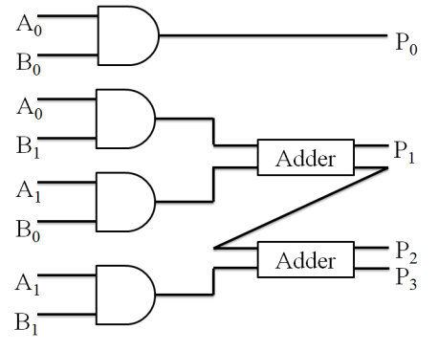
VEDIC MULTIPLIER
2-Bit Vedic Multiplier
Urdhwa Triyakbhyam
2×2 Vedic multiplier - Graphical representation
Hardware architecture

Slide 76
VEDIC MULTIPLIER
Design Approaches of Vedic Multiplier
Approach-1:
All the functional units (AND and Adder) are constructed using only KMD Gates
Approach-2:
Combination of KMD Gates (for Adder) and Fredkin (for AND logic) are used for construction.

Slide 77
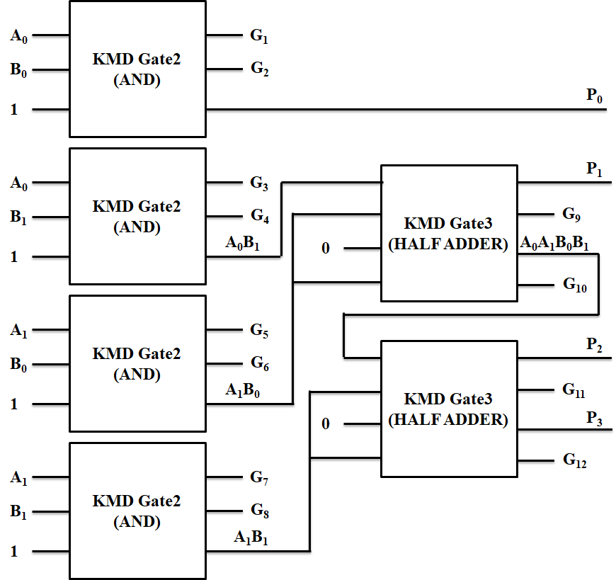
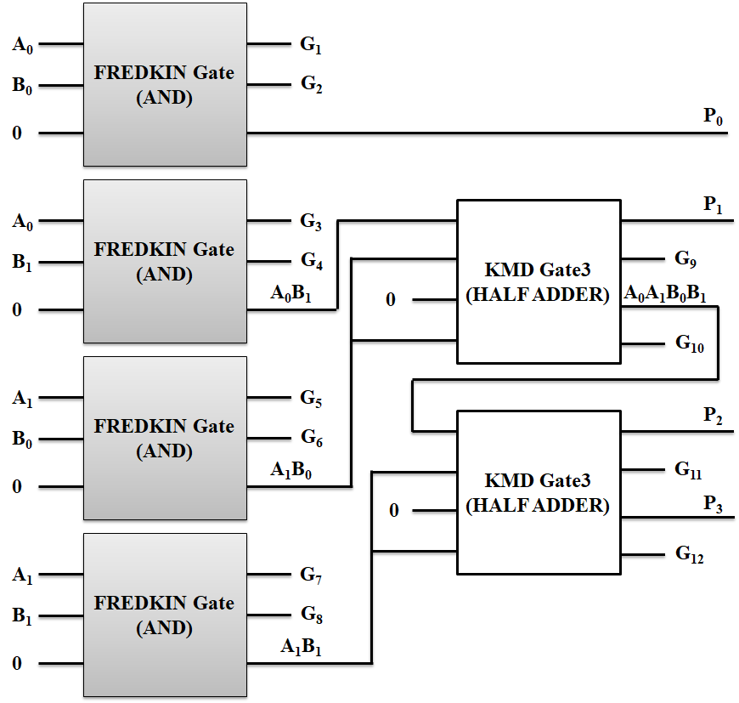
Approach 1 (2×2)
VEDIC MULTIPLIER
Architecture of Vedic Multiplier
Approach 2 (2×2)
The KMD Gates architecture
KMD and Fredkin Gates architecture

Slide 78
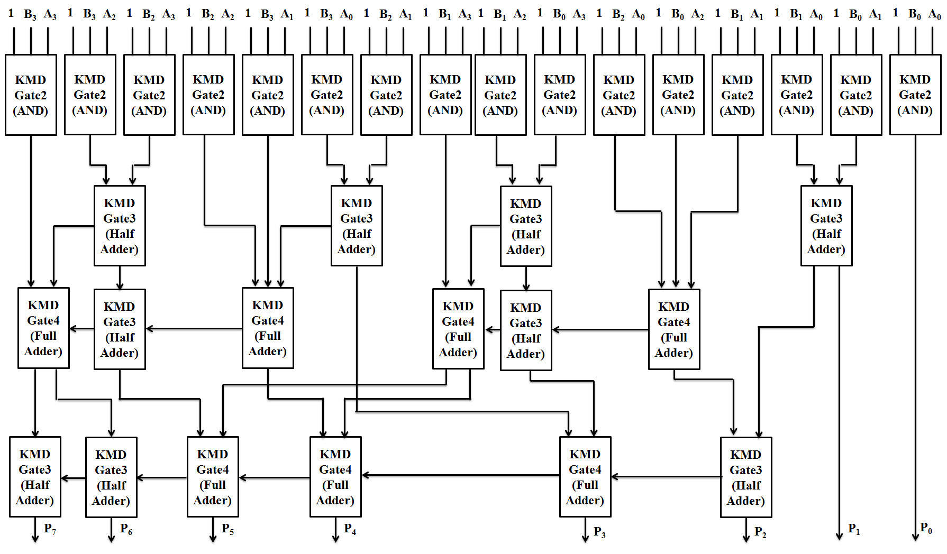
VEDIC MULTIPLIER
4×4 Vedic Multiplier

Slide 79
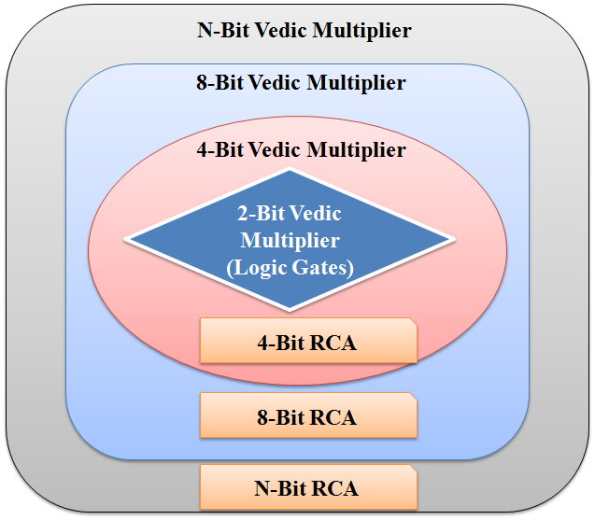
VEDIC MULTIPLIER
n-bit Vedic Multiplier Construction
.
.
.
.
.
.

Slide 80
VEDIC MULTIPLIER
QCA Realization of Vedic Multiplier (4×4)

Slide 81
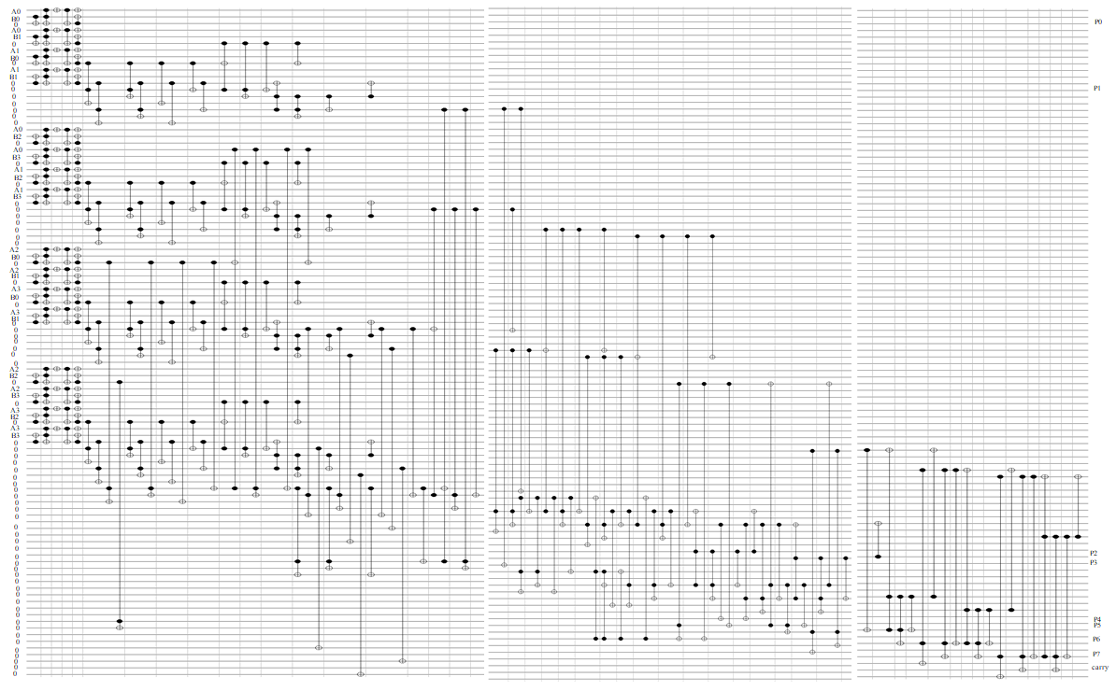
VEDIC MULTIPLIER
Quantum Circuit of Vedic Multiplier (4×4)

Slide 82
VEDIC MULTIPLIER
Performance Calculation of Vedic Multiplier
Gate | QC | GO | CI | NoG | Total Cost (QC + GO + CI + NoG) | Logical Calculations
AND logic (KMD) | 10 | 2 | 1 | 1 | 14 | 2α+4β+3γ
AND logic (Fredkin) | 5 | 2 | 1 | 1 | 9 | 2α+4β+1γ
Half Adder | 9 | 2 | 1 | 1 | 13 | 5α+2β+1γ
Full Adder | 12 | 3 | 2 | 1 | 18 | 6α+5β+2γ
4-bit Adder | 48 | 12 | 8 | 4 | 112 | 24α+20β+8γ
2-bit Parity preserving Reversible Vedic Multiplier ( four AND + two Half Adder)
Approach - 1 | 58 | 12 | 6 | 6 | 82 | 18α+20β+14γ
Approach - 2 | 38 | 12 | 6 | 6 | 62 | 18α+20β+6γ
4-bit Parity preserving Reversible Vedic Multiplier (four 2-bit VM + three 4bit RCA)
Approach - 1 | 376 | 84 | 48 | 36 | 544 | 144α+140β+80γ
Approach - 2 | 264 | 84 | 48 | 36 | 432 | 144α+140β+48γ
Observations:
The use of Fredkin gates reduces the Total cost of the multiplier in Approach-2

Slide 83
VEDIC MULTIPLIER
Performance Comparison of Vedic Multiplier
Cost Parameter | Vedic Multiplier (Normal) |  |  | Vedic Multiplier using only Parity Preserving |  |  |  | Proposed Vedic Multiplier |  | Percentage of Improvement
 | (Saligram & Rakshith 2013) | (Rakshith & Saligram 2013) | (Gowthami & Satyanarayana 2018) | Fredkin and Toffoli | NFT | RUG | UPPG | Approach-1 | Approach-2 | Approach-1 | Approach-2
Quantum Cost | 164 | 162 | 128 | 424 | 432 | 960 | 480 | 376 | 264 | 11.32% - 60.83% | 37.73% - 72.5%
Garbage Output | 43 | 62 | 40 | 160 | 64 | 64 | 112 | 84 | 84 | 25% - 47.5%
Constant Input | 33 | 29 | 31 | 48 | 16 | 48 | 48 | 48 | 48 | - | -
Number of gates | 33 | 37 | 31 | 60 | 48 | 36 | 48 | 36 | 36 | 25% - 40%
Total cost | 273 | 290 | 230 | 692 | 560 | 1108 | 688 | 544 | 432 | 2.85% - 50.90% | 22.85% - 61%
Logical Calculations | - | - | - | 112α+48γ | 144α+96β+144γ | 48α+144β+288γ | 144α+144β+220γ | 144α+140β+80γ | 144α+140β+48γ | - | -
Observations:
QC, GO, NoG and Total Cost is reduced. No improvement in CI.

Slide 84
VEDIC MULTIPLIER
Summary
Urdhwa Triyakbhyam Vedic multiplier designed using parity preserving reversible gates.
2×2 and 4×4 Vedic multiplier is realized in QCA.
Significant reduction in Quantum Cost (11.32% to 60.83% in approach-1 and 37.73% to 72.5% in approach-2), Garbage Output (25% - 47.5%) and Number Of Gates (25% - 40%).
Total cost of the proposed multiplier is reduced up to 61% .

Slide 85
CONCLUSIONS
Conclusions
Reversible KMD Gates with size of 3×3, 4×4 and 5×5 are proposed.
13-standard Boolean functions - 1.76 gates (Avg.).
ALU – Integrated Arithmetic and Logical Modules.
18 distinct ALU operations (10 arithmetic and 8 logical ).
Reduced quantum cost up to 69% and number of gates up to 21%.
FP Division – IEEE754; non-restoring .
Reduced Quantum Cost, Constant input and in Number of Gates.
Vedic multiplier – Urdhwa Triyakbhyam.
Reduced Quantum Cost (11-72%), Garbage Output (25 - 47%), and Number of Gates (25 - 40%).
Functional simulations – Quantum Cellular Automata (QCA);
Quantum Circuits – RCViewer+.

Slide 86
REFERENCES
References
Anantha Lakshmi, AV & Gnanou Florence Sudha 2017, ‘Design of a reversible floating-point square root using modified non-restoring algorithm’, Microprocessors and Microsystems, vol. 50, pp. 39–53.
Antoine Be´rut, Artak Arakelyan, Artyom Petrosyan, Sergio Ciliberto, Raoul Dillenschneider & Eric Lutz 2012, ‘Experimental verification of Landauer’s principle linking information and thermodynamics’, Macmillan Publishers Limited, vol. 483, pp. 187-190.
Arabani SR, Reshadinezhad MR & Haghparast M 2018, ‘Design of a parity preserving reversible full adder/subtractor circuit’, International Journal of Computational Intelligence Studies, vol. 7, no. 1, pp. 19-32.
Ashvin Chudasama, Trailokya Nath Sasamal & Jyoti Yadav 2018, ‘An efficient design of Vedic multiplier using ripple carry adder in Quantum-dot Cellular Automata’, Computers and Electrical Engineering, vol. 65, pp. 527-542.
Bandan Bhoi, Neeraj Kumar Misra & Manoranjan Pradhan 2017, ‘Design and evaluation of an efficient parity-preserving reversible QCA gate with online testability’, Cogent Engineering, vol.4, pp. 1-18.
Bennett, CH 1973, ‘Logical Reversibility of computation’, IBM Journal of Research and Development, vol. 17, pp.525 – 532.
Bibhash Sen, Manojit Dutta, Mrinal Goswami & Biplab Sikdar, K 2014, ‘Modular Design of stable reversible ALU by QCA multiplexer with increase in programmability’, Microelectronics Journal, vol. 45, no. 11, pp. 1522–1532.
Faraz Dastan & Majid Haghparast 2011, ‘A novel nanometric fault tolerant reversible divider’, International Journal of the Physical Sciences, vol. 6, no.24, pp. 5671-5681.
Fredkin, E & Tommaso Toffoli 1980, ‘Conservative Logic’, MIT Laboratory for Computer Science, International Journal of Theoretical Physics vol. 21, pp. 219–253.
Gowthami, P & Satyanarayana, RVS 2018, ‘Performance Evaluation of Reversible Vedic Multiplier’, ARPN Journal of Engineering and Applied Sciences, vol. 13, no. 3, pp. 1002-1008.
Jamal, L & Babu, HMH 2013, ‘Efficient approaches to design a reversible floating point divider’, Proceedings of the IEEE International Midwest Symposium on Circuits and Systems, vol. 13, pp. 3004–3007.
Landauer, R 1961, ‘Irreversibility and heat generation in the computing process’, IBM Journal of Research and Development, vol. 5, no. 3, pp. 183-191.
Rakshith, TR & Saligram, R 2013, ‘Design of High Speed Low Power Multiplier using Reversible logic: a Vedic Mathematical Approach’, International Conference on Circuits, Power and Computing Technologies (ICCPCT-2013), pp. 775-781.
Saligram, R & Rakshith TR 2013, ‘Optimized Reversible Vedic Multipliers for High Speed Low Power Operations’, IEEE Conference on Information and Communication Technologies (ICT 2013), pp. 809-814.
Trailokya Nath Sasamala, Ashutosh Kumar Singh & Anand Mohanaa 2016, ‘Efficient design of reversible ALU in quantum-dot cellular automata’, Optik Journal, vol. 127, pp. 6172–6182.

Slide 87
PUBLICATONS
Publications
Annexure – I / Revised Journal List 2019
Kamaraj, A & Marichamy, P 2019, “Design of fault-tolerant reversible Vedic multiplier in quantum cellular automata”, Journal of the National Science Foundation of Sri Lanka, vol. 47(4), pp.371-382. (Impact factor = 0.419) (ISSN No.: 1391-4588; S. No. 7605 – Anna University revised Journal list).
Kamaraj, A & Marichamy, P 2019, ‘Design of integrated reversible fault-tolerant arithmetic and logic unit’, Microprocessors and Microsystems, vol. 69, pp. 16–23. (Impact Factor = 1.049) (ISSN No.: 0141-9331; S. No. 8390 – Anna University revised Journal list).
Kamaraj, A & Marichamy, P 2018, ‘Design of Fault-Tolerant Reversible Floating Point Division’, Informacije MIDEM – Journal of Microelectronics, Electronic Components and Materials, vol. 48, no. 3, pp. 161–171. (Impact Factor = 0.476) (ISSN No.: 0352-9045; S. No. 4902 – Anna University revised Journal list).
Annexure – II
Kamaraj, A, Marichamy, P, Karthiga Devi, S & Nagalakshmi@ Subraja, M. 2015, ‘Design and Implementation of Adders using Novel Reversible Gates in Quantum Cellular Automata’, Indian Journal of Science and Technology, vol. 9, no.8, pp.50-57 (ISSN (Print) No.: 0974-6846, Sl. No.8167 – Anna University Annexure-II, Scopus, h index = 33).
Kamaraj, A, Marichamy, P & Abinaya, M 2015, ‘Design of Reversible Logic based Area Efficient Multilayer Architecture Router in QCA’, International Journal of Applied Engineering Research, Research India Publications, vol. 10, no.1, pp. 140-144 (ISSN No.: 0973-4562, Sl. No.8565 – Anna University Annexure-II, Scopus, h index = 25).
Kamaraj, A, Marichamy, P & Ramya, S 2015, ‘Design of Reversible Logic based Single Precision Floating Point Multiplier for FFT’ International Journal of Applied Engineering Research’, Research India Publications, vol.10, no.1, pp. 157-162 (ISSN No.: 0973-4562, Sl. No.8565 – Anna University Annexure-II, Scopus, h index = 25).
Kamaraj, A, Marichamy, P, Kalyana Sundaram C & Senthil Kumar J, 2014, ‘Design And Implementation of A Reversible Logic Based 8-Bit Arithmetic and Logic Unit’, International Journal of Computers and Applications, vol.2, no.1, pp.49-55 (ISSN No.: 1206-212X, Sl No.8696 – Anna University Annexure-II, Scopus, h Index = 12).

Slide 88
COMMENTS - EXAMINERS
Comments from Examiners
Indian Examiner
S. No | Comments of the Examiner | Response of the Scholar
1 | What is the impact of higher garbage output on the performance? Give an example | Leads to increase in Performance Cost (Total Cost, Constant Inputs).
2 | Any implementation done in practice, any of the module that you have carried out? | No hardware is realized so far. D-Wave System, Canada working in Quantum Computing (https://www.dwavesys.com/)
3 | Is there any disadvantage / limitations of your design? Also highlight the potential applications of your research outcomes. | It is a Theoretical Research work. Implementation requires new manufacturing process and tools. This research is useful for Low Power Applications and Devices.

Slide 89
COMMENTS - EXAMINERS
Comments from Examiners
S. No. | Comments of the Examiner | Response of the Scholar
1. | The one most important suggestion is the definition for all the adopted symbols which are requires clear. For example, the “alpha”, “beta”, and “gama” expressed in Table 3.5 at pp.86. Please check up through the Thesis. | Definition of “alpha”, “beta”, and “gama” is given in section 1.7.4 of Chapter-1. As per the examiner’s comment, the meaning of “alpha”, “beta”, and “gama” is additionally included in the ‘List of Symbols and Abbreviations’ section in pp. xx. The meaning of “alpha”, “beta”, and “gama” is included in Table 3.5 (page 86).
2. | Several reports of performance analysis are expressed in Chapter 3 in which there are much of the comparison results are shown detail. However, it is suggested that those shown values can be expressed clearly with abstract discussion. For example, the Quantum Cost is “9” shown on Table 3.12 for KMD Gate3 the proposed design in pp.108, to explain with reasons for obtaining “9” is necessary. | The definition, explanation and examples are discussed in Chapter 1, Section 1.7.1, page 11. As per the examiner’s comment, a calculation of Quantum Cost is explained with an example for the KMD Gates. This is included in the thesis as Appendix-1. These Quantum Costs are used throughout the Thesis for performance calculations of ALU, Floating Point Division and Vedic Multiplier.
.3 | It is also another interesting issue to be addressed, what the algorithm definitely to define the “Logical Calculations” is shown in the last column of Table 3.1. | In the Chapter1, Section 1.7.4 at page 13 given with the definition, explanations and method to obtain Logical Calculations are given with examples. Based on this information, the Logical Calculations of Table 3.1 (Page.77) is obtained. The same logical calculation definition is adopted throughout the Thesis.
4. | There are several issues suggested discussed deeply, for example, the issue claimed in Table 4.8. “… the performance cost of … linearly increase…”. Please explain clear. | The Section 4.3, Table 4.8, pp.127 shows the performance cost of n-bit ALU. The n-bit ALU can be constructed by replicating the 1-bit ALU structure for n number of times. In this process there is no additional hardware is required to construct n-bit ALU. Thus the performance cost of the ALU is linearly increasing with number of bits (n). In other words, number of bits and performance cost are directly proportional for the ALU. Hence there is no additional hardware overhead.
5. | The reviewer suggests that the ways to set up the simulation environment are required explained briefly. Thus, it can make sense the trusties for the proposed ALU expressed in Chapter 4. | The Simulation Environment and its specifications are explained and included in the thesis as Appendix-2. The same environment is maintained for the simulation of KMD Gates, ALU, Floating Point Division and Vedic Multiplier in QCA.

Slide 90
COMMENTS - EXAMINERS
Comments from Examiners
S. No. | Comments of the Examiner | Response of the Scholar
6. | Is there any reason or referred that “The proposed ALU performs 18 distinct Arithmetic and …” expressed in Chapter 4. That is, if the results of the performance will become degradation when the number of Arithmetic increased. | The results show that there is no degradation in the performance of ALU due to increase in the number of arithmetic operations. The performance of ALU using KMD is improved as there is a reduction in the total cost (Ref. Section 4.3, Table 4.6, pp.125).
7. | All the acronym symbols of the context should be noted through all over the thesis. | The acronym and symbols used in the entire thesis are included the section ‘List of Symbols and Abbreviations’ in pp. xviii - xx
8. | Please give some words to express the operation of quantum circuit shown in Figure 5.9 and Figure 6.11? Moreover, the explanation to the methods for obtaining Quantum Cost expressed in pp.141 is requested. | The quantum circuit is obtained for the circuits using RCViewer + software. Quantum circuits are constructed using quantum dots. The quantum circuit operation is same as the functioning of hardware elements of the circuit. A calculation of quantum cost shown in Appendix-1.
9. | Specifically, it interesting in providing 2 approaches discussed in Chapter 6. The results from the corresponding way seem natural. Please give the reasons for describing the two schemes when the defense rehearsal is held. | In order to reduce the quantum cost of the Vedic Multiplier without compromising in Parity preservation and functionality Approach 2 is adopted in Chapter 4 and Chapter 6. The Garbage output, Constant Input and Number of Gates are remains the same in both approaches as shown in Section 6.4, Table 6.2 (pp.162) and Table 6.3 (pp.163).
10. | Though there are huge of articles addressing in studying on reversible logics, the results comparison of this investigation to the existing works has provided in the Thesis. It is worth give some positive words to the Scholar, keep on the investigation to the future scope highlighted in the desertion | The design of quantum circuits with controlled V and V⁺ decomposition and integrated qubit optimization are in progress for the desertion work.

Slide 91


THANKS
Thanks to…
Supervisor – Dr.P.Marichamy
Doctoral Committee Members (Dr.M.Vijayaraj, GCE, Tirunelveli & Dr.S.Rajaram, TCE, Madurai)
P.S.R Engineering College, Sivakasi
Mepco Schlenk Engineering College, Sivakasi

Slide 92
3×3 Reversible Gates
Peres Gate
R Gate
A
P=A
A
P=A⊕B
B
Q=A⊕B
B
Q=A
Peres
R Gate
TR Gate
URG Gate
PPRG Gate
SAM Gate
RM Gate and
RUG Gate
C
R=AB⊕C
C
R=AB⊕C’
TR Gate
URG Gate
A
P=A
A
P=AB⊕C
B
Q=A⊕B
B
Q=B
C
R=AB’⊕C
C
R=(A+B)⊕C
PPRG Gate
SAM Gate
A
P=A⊕B
A
P=A’
B
Q=AC+B’C’
B
Q=A’B⊕AC’
C
R=A’C+B’C’
C
R=A’C⊕AB

Slide 93
4 × 4 Reversible Gates
A
R1 Gate
P=A⊕C
A
TSG Gate
P=A
B
Q=B⊕C⊕AB⊕BC
B
Q=A’B’⊕B’
TSG Gate
HNG Gate
MRG Gate
UPPG Gate
PAOG Gate
SMS Gate
OTG Gate
C
R=A⊕B⊕C
C
R=(A’C’⊕B’)⊕D
D
S=AB⊕BC⊕C⊕D
D
S=(A’C’⊕B’)D⊕(AB⊕C)
A
OTG Gate
P=A
A
PAOG Gate
P=A
B
Q=A⊕B
B
Q=A⊕B
C
R=A⊕B⊕D
C
R=AB⊕C
D
S=(A⊕B)D⊕(AB⊕C)
D
S=((A⊕B)⊕D)⊕(AB⊕C)
A
SMS Gate
P=A⊕C⊕D
A
BME Gate
P=A
B
Q=D⊕BC
B
Q=AB⊕C
C
R=C
C
R=AD⊕C
D
S=BC⊕C⊕B⊕D
D
S=A’B⊕C⊕D

Slide 94
Annexure I (for Comment No. 2)
* Quantum Cost of Toffoli is 5 and Feynman is 1 (Table 1.3, page 12)
S. No | Reversible Gate | Type and Number of Primitive Gates for the construction | Quantum Cost
 | KMD Gate1 | Toffoli – 1; Feynman – 4 | 9
 | KMD Gate2 | Toffoli – 1; Feynman – 5 | 10
 | KMD Gate3 | Toffoli – 1; Feynman – 4 | 9
 | KMD Gate4 | Toffoli – 1; Feynman – 7 | 12

Slide 95
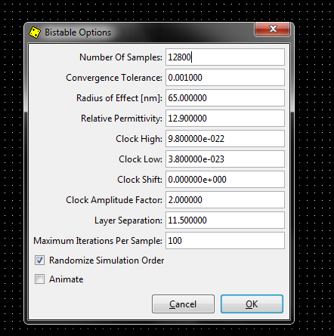
Annexure II (for Comment No. 5)
Simulation Environment
The simulation environment chosen for the proposed design in QCA Tool is Bistable Simulation engine with exhaustive simulation.

